Slide 1



Countrywide Mortality Surveillance for Action (COMSA) in Mozambique:
A platform for monitoring mortality and causes of death
Celso Monjane & Almamy Malick Kante
National Institute of Health (Mozambique) &
John Hopkins University (USA)
November 28, 2022

Slide 2
Mozambique
Located in southeastern Africa bordered by the Indian Ocean
Population: 31.6 million (65.5% in rural areas)
Life expectancy: 55.7 years old
HIV prevalence: 13.2%
Infectious diseases are main causes of morbidity and mortality with NCDs and trauma increasing – triple burden of diseases

Slide 3
The availability of recent mortality data has been a challenge in Mozambique
  Lacks a system that generates high quality annual recent data on mortality and causes of death to inform progress monitoring and programs and policy decision-making
    CRVS not yet optimal: only ~7% of deaths are registered nationally by cause in Mozambique
    HMIS: only 23% of deaths occur in health facilities and most are not certified with causes of death
    Household surveys/censuses: have limited mortality data and causes of death
Census 1997
DHS 2003
Census 2007
DHS 2011
Census 2017
DHS 2022
COMSA/SIS-COVE (since 2018)
continuous
6Y
4Y
4Y
6Y
5Y

Slide 4
A community surveillance system for disease and causes of death
Mozambique initiated a national sample registration system in 2018 (called COMSA) to generate continuous data on mortality, cause of death, and factors related to death
  Among the first African countries to producing mortality and causes of death data at national and subnational levels
  Led and implemented by the country (INS and INE)
  Sustainability plan in place to continue and expand the system for disease surveillance and collect other program data

Slide 5
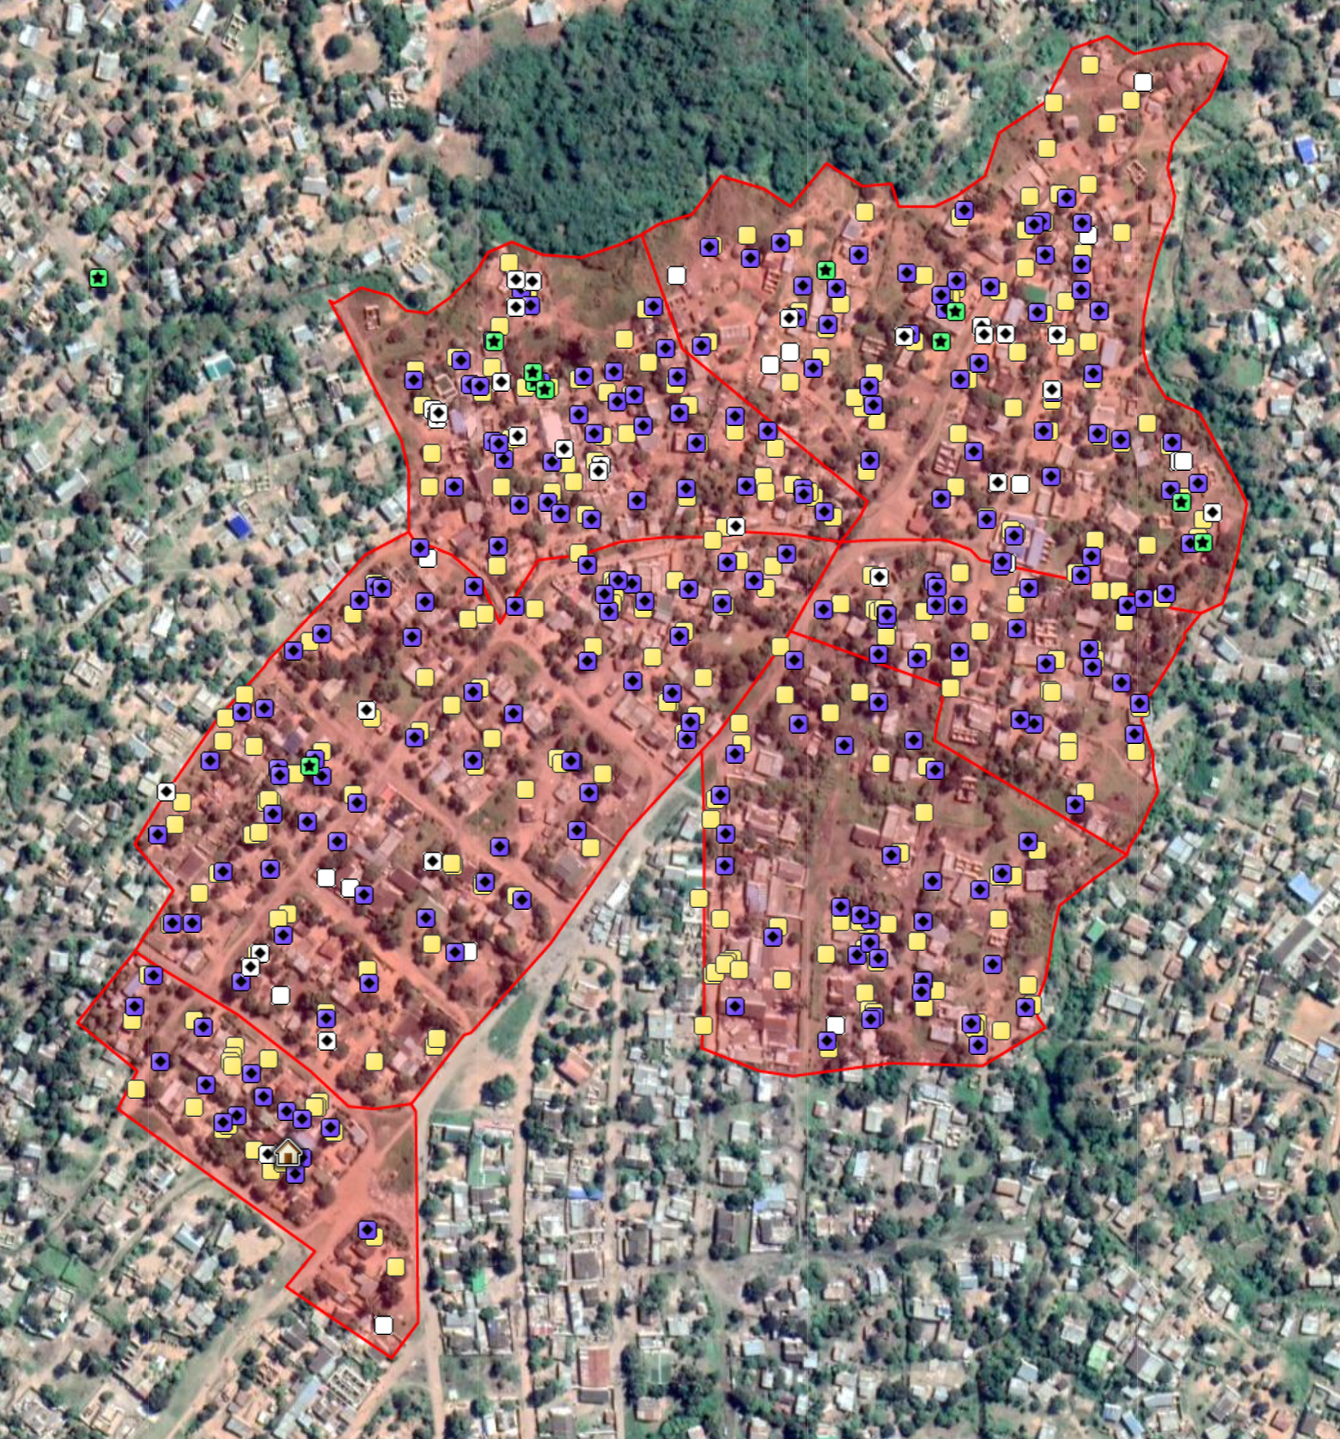
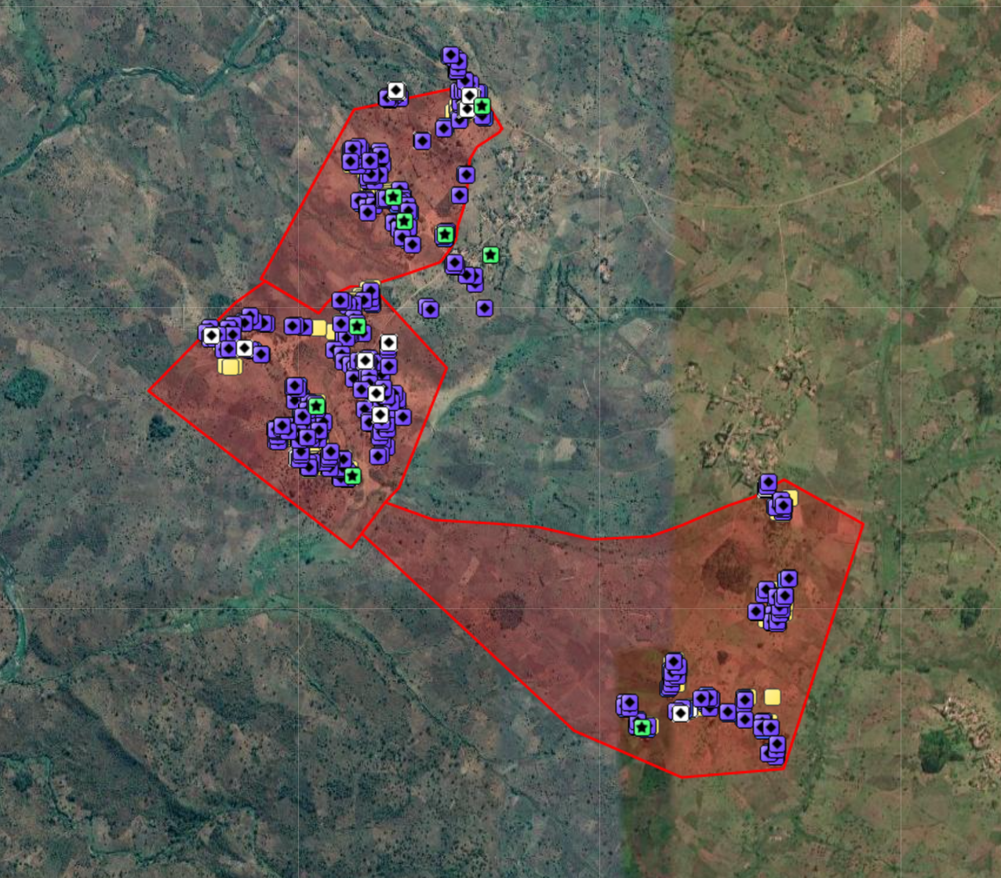
COMSA has a digitized sample and data collection
Random selection of 700 clusters
Representative at national and provincial levels
Large cluster (~300, households)
Surveillance of total population of each cluster
180,000 households
800,000 population
113
Urban cluster
40
106
53
85
118
29
Rural cluster
49
COMSA cluster
36
36
Maputo City
35
Notes:
How large and representative the COMSA platform compare to other surveys (last national survey, IMASIDA 2015)
Just read

Slide 6

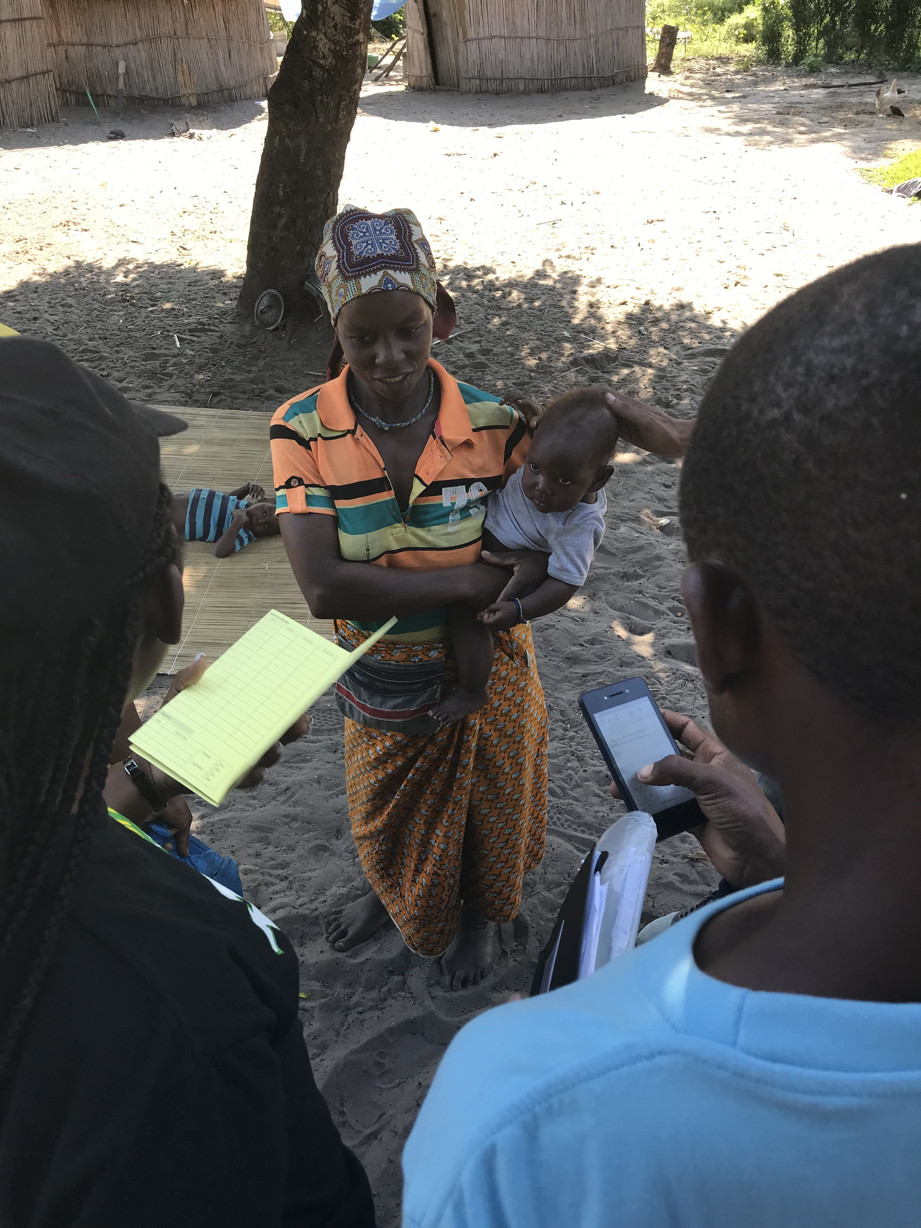
COMSA/SIS-COVE real time data reporting and analysis
www.comsamozambique.org

Slide 7
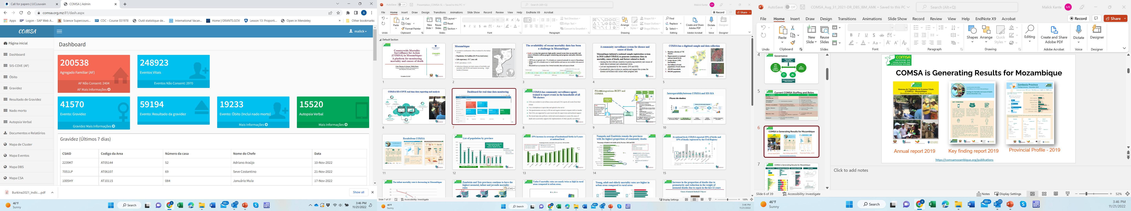
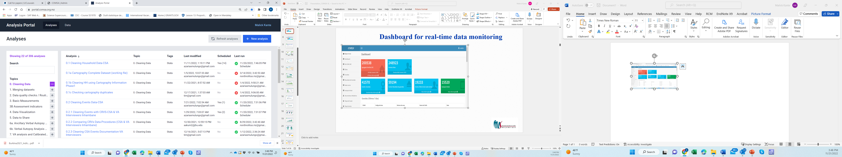
Real-time data monitoring and analysis
Dashboard
Analysis platform

Slide 8
Data dissemination and use
Annual report
Key finding report
Provincial Profile

Slide 9
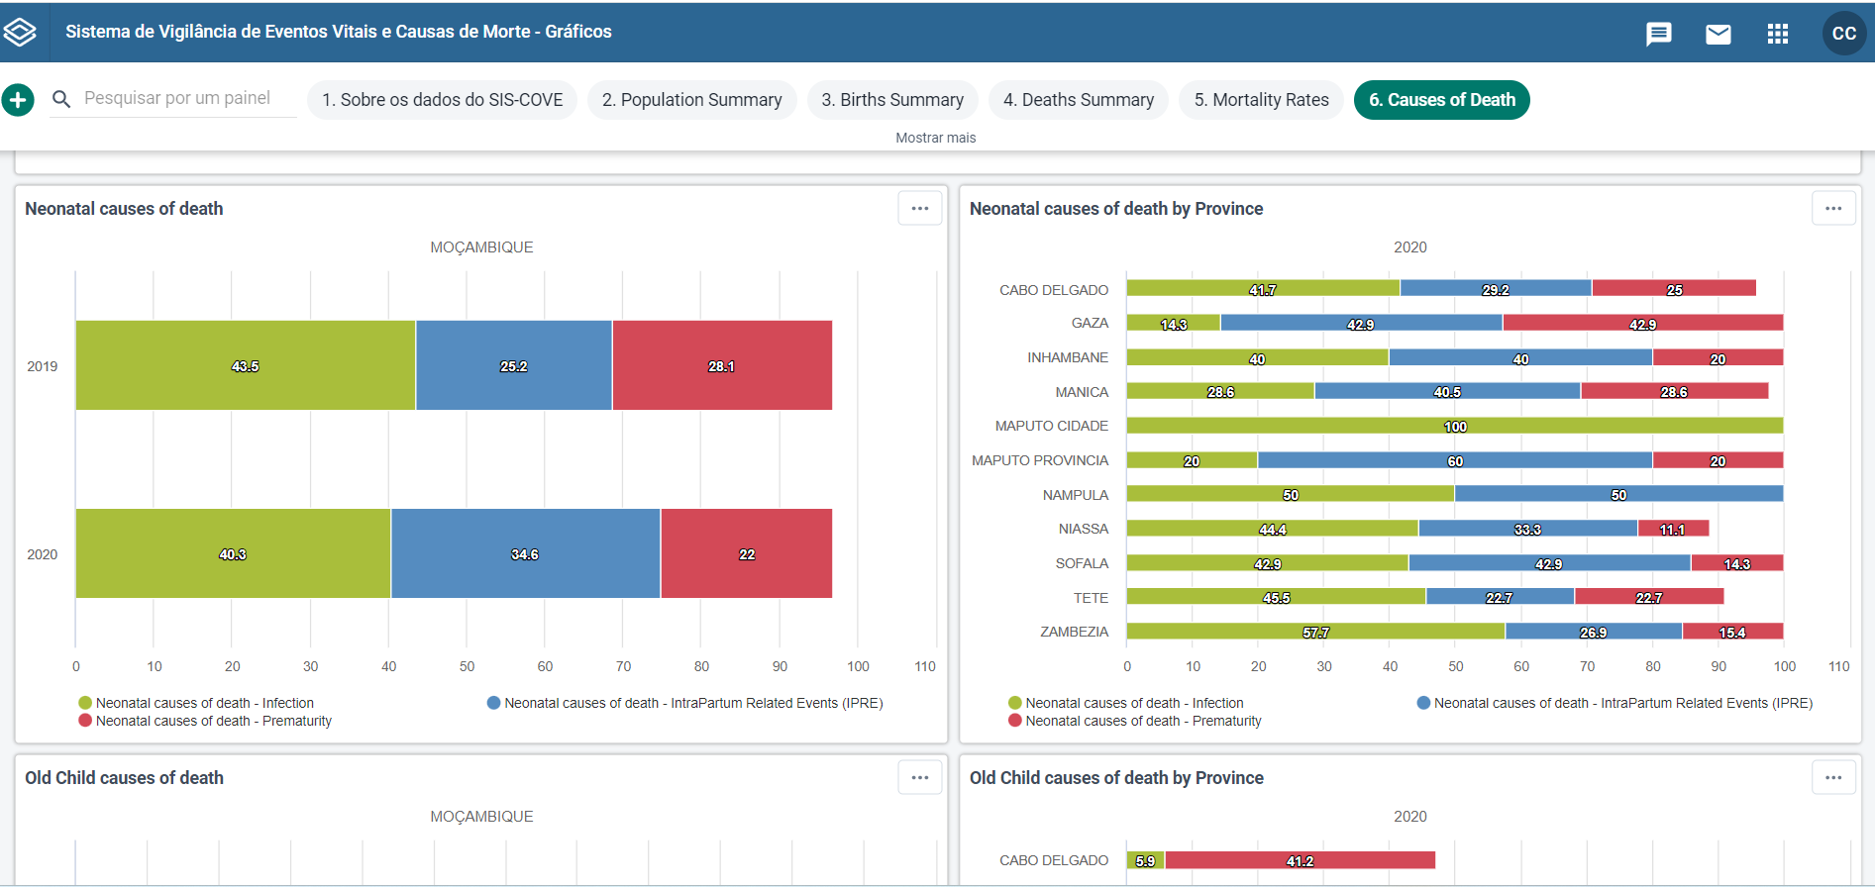
Interoperability with the DHIS2:
(SIS-MA_Sis-COVE Module)

Slide 10
Results

Slide 11
National: 30% of reported births and 15% of reported deaths registered to the Civil Registry

Slide 12
National level: 10% increase in coverage of institutional births in 8 years
Institutional births
2019: 65% (n=14,980)
2020: 64% (n=15,561)
DHS 2011: 55% of births occurred in a health facility

Slide 13
National level: 10% increase in coverage of institutional births in 8 years
Institutional births
2019: 65% (n=14,980)
2020: 64% (n=15,561)
DHS 2011: 55% of births occurred in a health facility

Slide 14
National level: 25% of deaths occured at a health facility
Intra-hospital deaths
2019: 24% (n=4,254)
2020: 25% (n=3,583)
INCAM 1(2007): 21% of deaths occurred in a health facility
Maputo City and Province: ~ 55%
Nampula and Zambézia: ~ 20%

Slide 15
Neonatal, infant and under-5 mortality still decreasing in Mozambique
219
178
124
97
80.2
57
79.8
64
45.8
45.2
48
23.2
32
23.8

Slide 16
Neonatal, Under-five mortality rates
High neonatal and under-five mortality
Higher mortality in rural than urban areas
Large variability of child mortality across provinces
Notes:
Under-5 mortality rates are nearly twice as high in rural areas compared to urban areas.

Slide 17
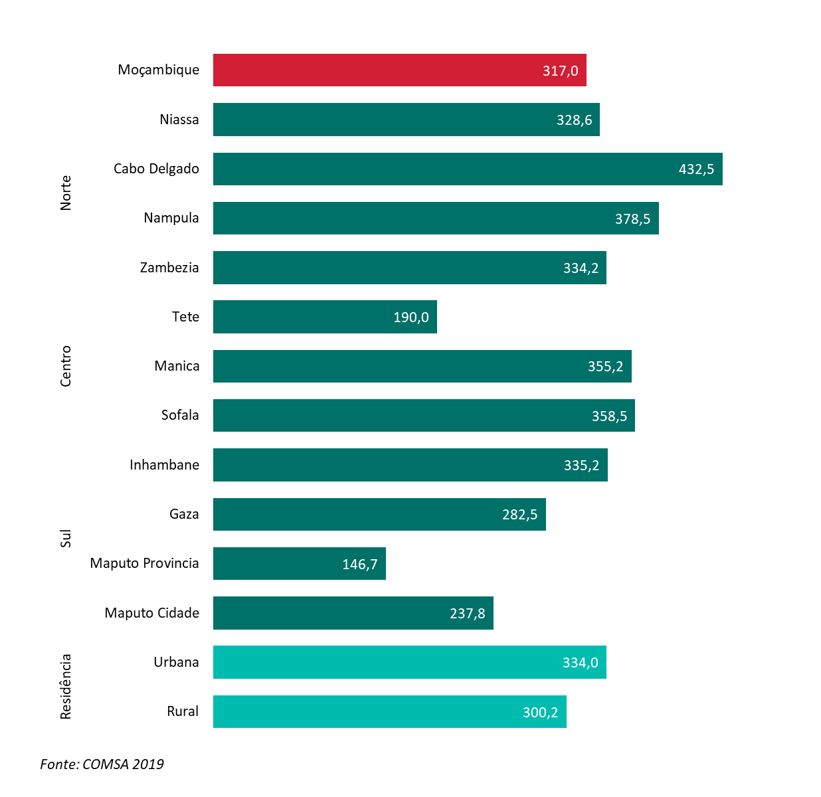
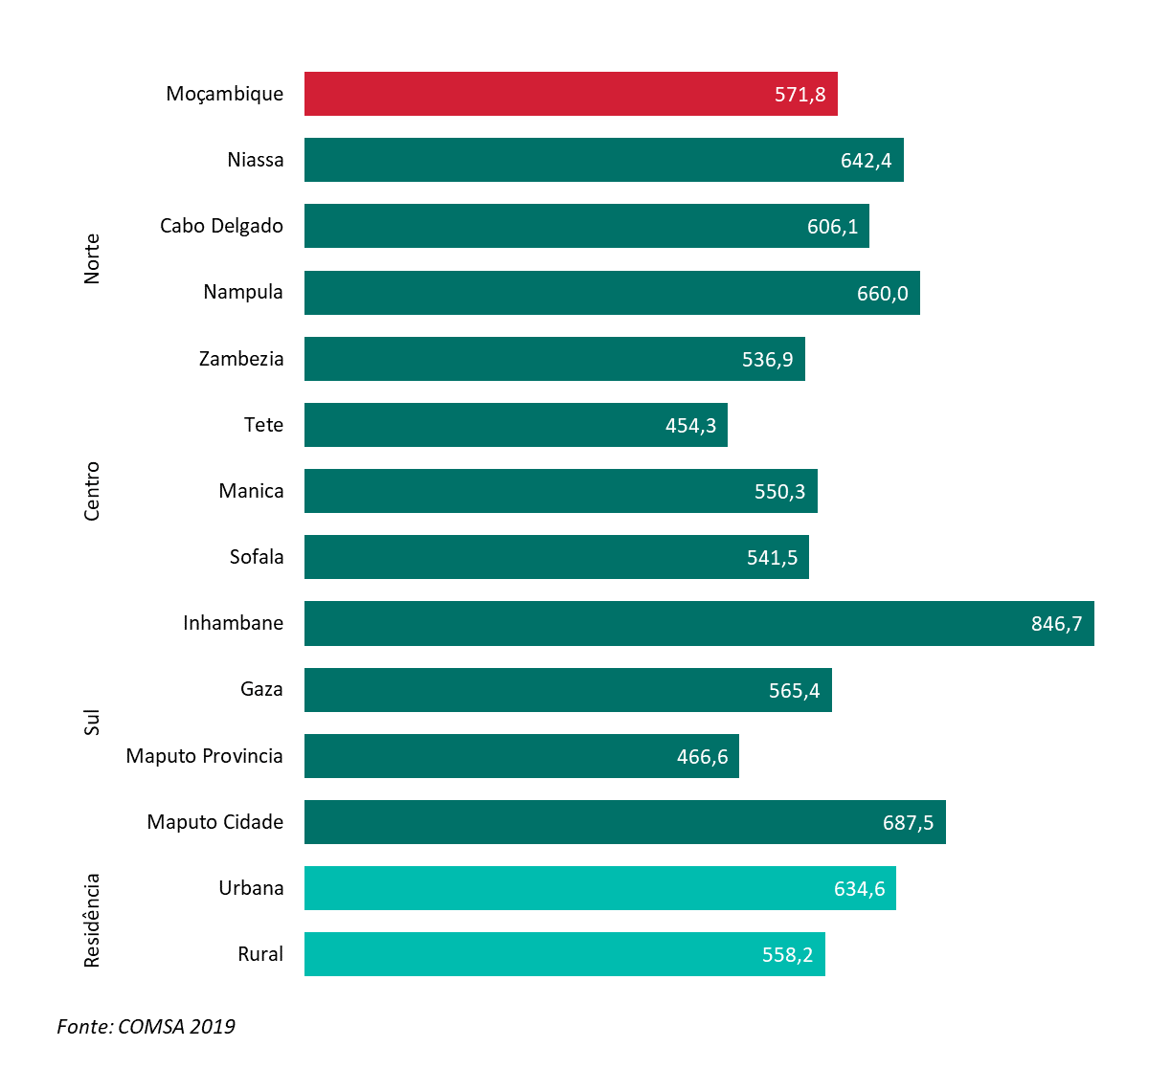
Adult mortality rates are higher in urban areas compared to rural areas
15-59years-old
+60years-old

Slide 18
Little progress in maternal mortality ratio since the early 2000’s
2019-2020 MMR (deaths per 100,000 live births)
Census2007: 500
Census2017: 452
Slightly higher in
rural areas and
northern and central regions

Slide 19
Increase in the proportion of deaths due to prematurity and reduction in the weight of deaths due to sepsis in the last 12 years
Neonates (0-27days)
2007 INCAM:
Sepsis (35%), IPRE (16%), Prematurity (6%), Other infection (10%)

Slide 20
No change in the profile of causes of death in children aged 1 to 59 months-olds but increase of deaths due to trauma in older children 5-14-years-olds
Children 1-59 months-olds
Children 5-14 years-olds
2007 INCAM:
Malaria (51%), HIV (16%), Diarrhea (7%), pneumonia (7%)
2007 INCAM:
Malaria (41%), HIV (14%), Trauma (8%), Diarrhea (6%)

Slide 21
Increase in the burden of deaths from NCDs in adults aged 50 and over
2007 INCAM: 15Y+:
HIV (40%), malaria (14%), Trauma (6%)

Slide 22
Low demand for health care for neonates
Decided whether to seek care
Care chosen
Outcomes of formal care (n=97)
581 neonatal deaths
9/13 complied with referral
8 died before receiving care
Decided whether to seek care
Care chosen
Outcomes of formal care (n=904)
1324 deaths aged 1-59 months
75/92 complied with referral
28 died before receiving care

Slide 23
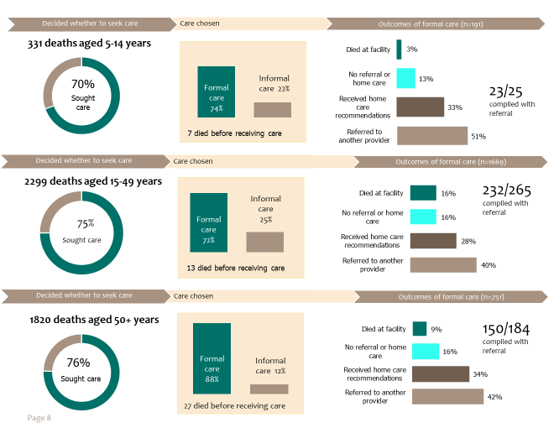
High rates of referral of older adults to other health facilities that result in deaths

Slide 24
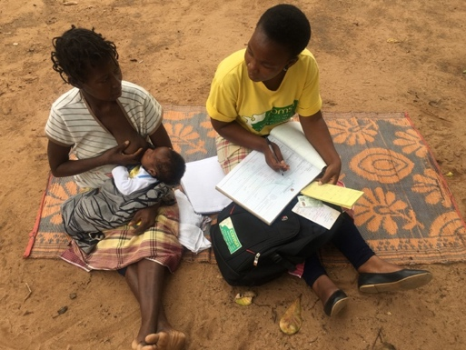
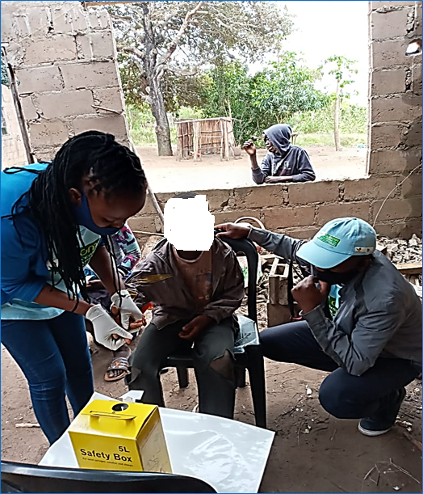
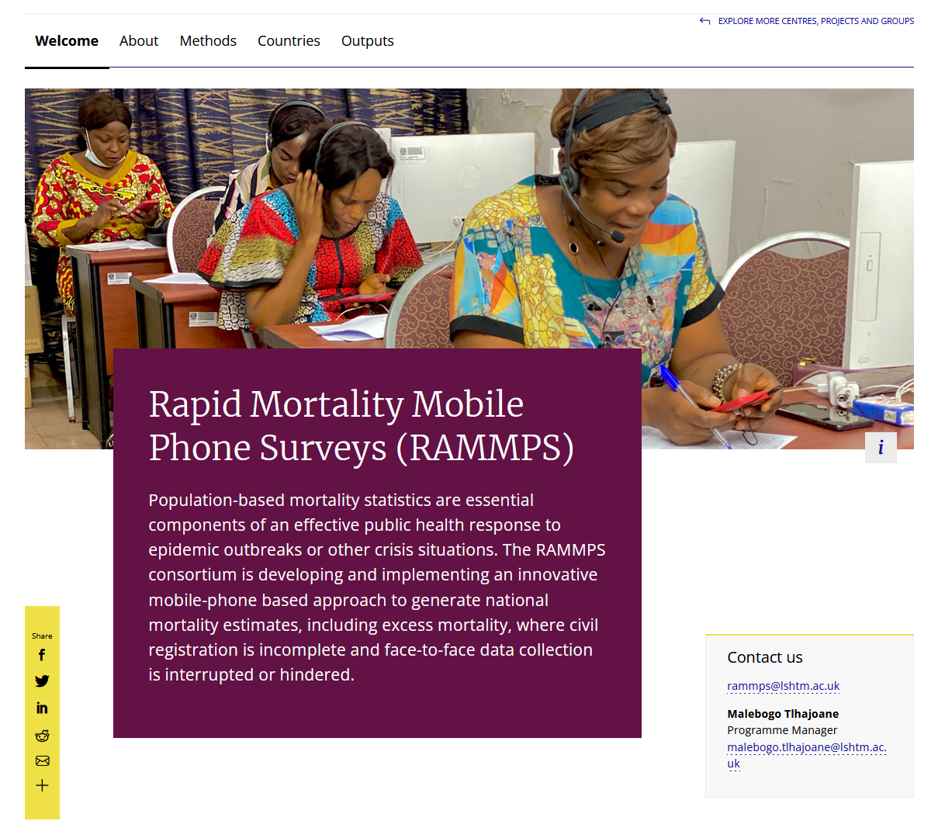
A strong platform for additional studies
Strengthening e-CRVS in Inhambane
Dried Blood spot (DBS) in Zambezia
Rapid Mortality Mobile Phone Survey (RaMMPS)
Impact of COVID on Reproductive maternal, newborn child health and Nutrition (RMNCH-N)
Maternal mortality surveillance

Slide 25
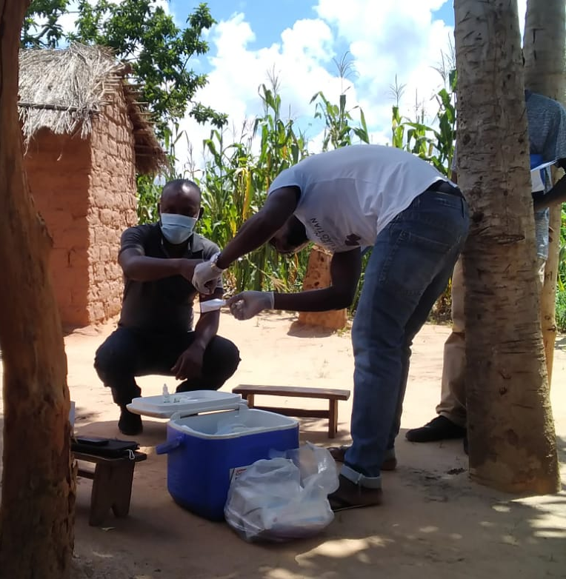
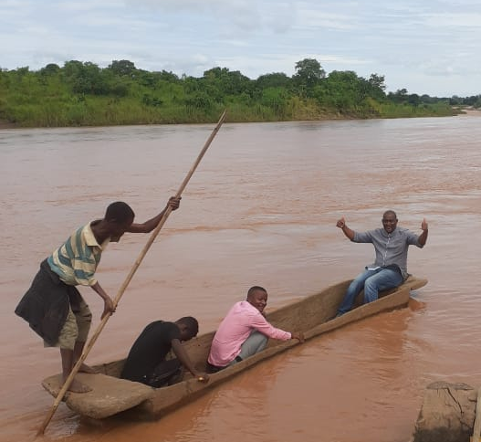
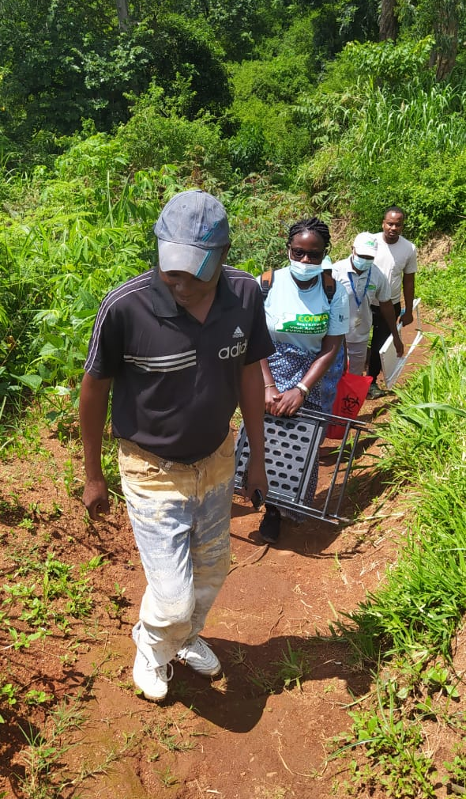
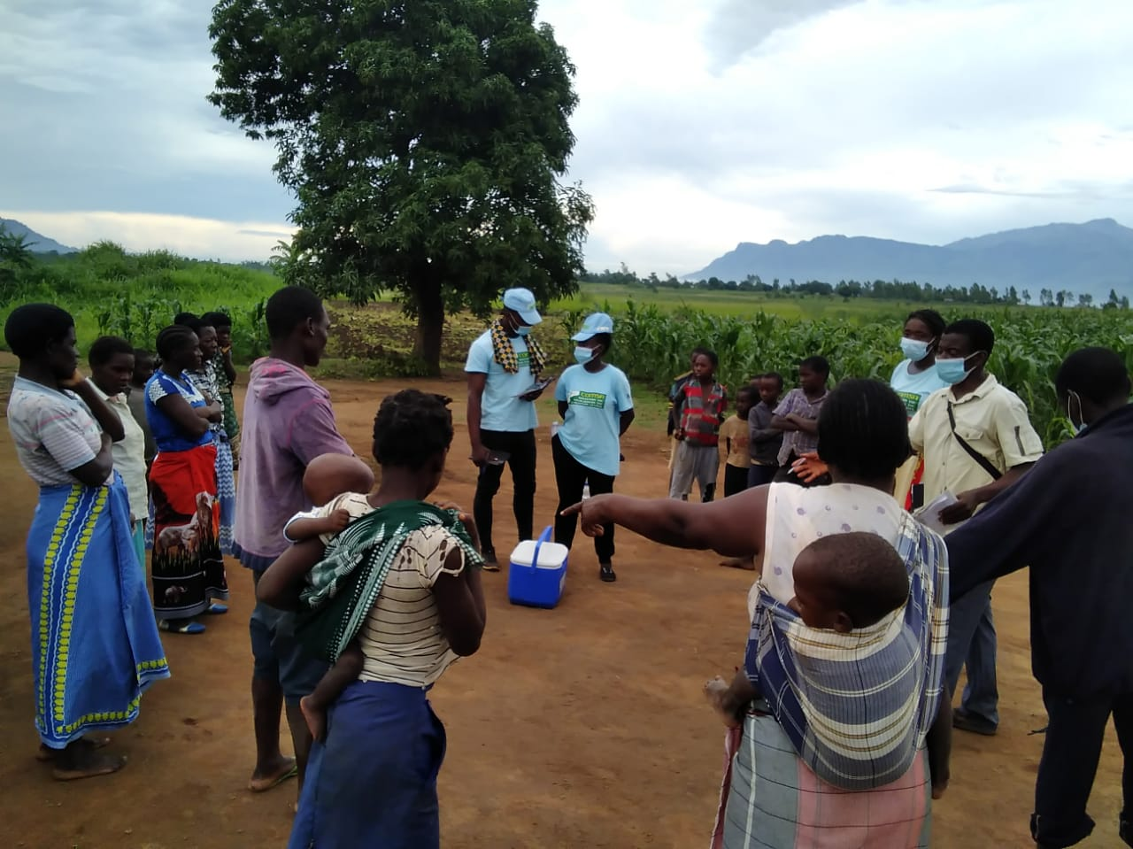
Challenges
Extremely challenging context
COVID-19 delays to field and laboratory supplies, Zambezia terrain, logistics

Slide 26
Conclusions
COMSA is a unique platform in Mozambique (and in Africa) and generates highly relevant data for monitoring the SDGs and selected interventions
The System has shown its potential through the support of selected interventions and as a framework for integrated surveillance;
Integrated disease surveillance are needed to support interventions and primary health care;

Slide 27


Obrigado!

Slide 28
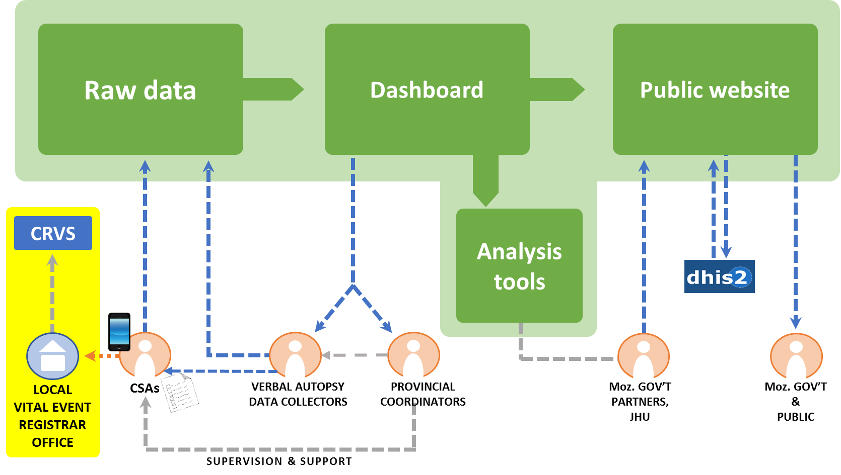
Designing COMSA Mozambique to Strengthen CRVS
COMSA Data System
3. Currently under-discussion with CRVS Unit
Assess compatibility between COMSA and CRVS data systems system
Make COMSA data on births, deaths, and cause of death available to CRVS
CRVS will document accuracy of events
CRVS upload data into CRVS system and issue event certificate to the family
Note: By law registration must be done by CRVS. COMSA cannot link directly its system to CRVS data system
2. Pilot electronic reporting by CSAs using directly CRVS birth and death forms in one province
Mozambique CRVS System
1. SMS notification of births and deaths by CSAs to e-CRVS system and receipt of unique event ID issued by CRVS system (CRVS must approve the CSAs as notifiers)
CSA
Community Level

Slide 29

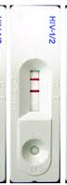
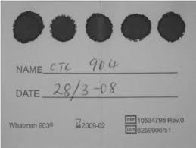
DBS in Zambezia
59%
Were positive for Malaria
HIV RDT
+
Malaria RDT
DBS spots for MagPix bead-based assays
+
+
DBS spots for biorepository

Slide 30
COMSA Achievements in Mozambique
Innovative Sample Registration System that is generating data on mortality and cause of death at national and provincial levels
Innovative statistical analysis combining VA and MITS to produce better estimates of cause of death at national and provincial levels
Stable platform for collection of other surveillance data (Malaria, HIV, VPDs, and NTDs)
An understanding of pathways to survival through social autopsy analysis
See www.comsamozambique.org for more information

Slide 31
Recommendations for strengthening surveillance
Collaboration
Involvement of key stakeholders
Human Resources
Investment of community health workers
Sustainability
Integrated serosurveillance
Health information systems
Using of existing platforms

